Slide 1

Lesson no 1
THE TRANSITION TO THE INFORMATION AGE

Slide 2
01. History
02. Weapons evolution
CONTENTS
03. Digital Revolution
04. Information Domains

Slide 3
01. History

Slide 4
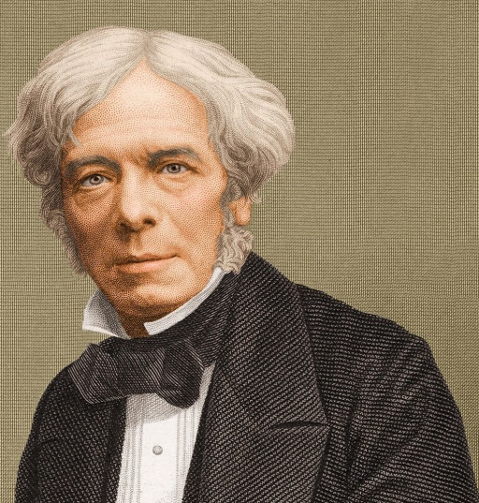
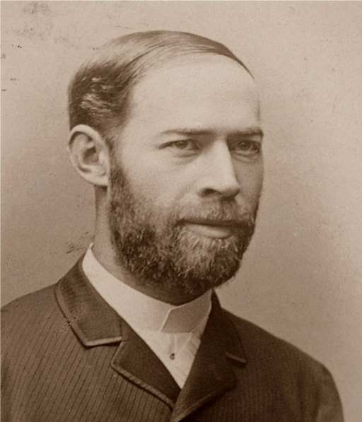
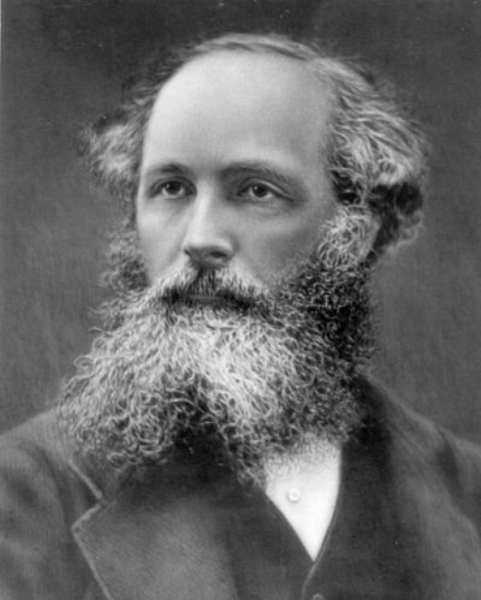
Michael Faraday
1791 - 1867
Heinrich Hertz
1857 – 1894
1888
James Clerk Maxwell
1831 – 1879
1865
A DYNAMICAL THEORY OF THE ELECTROMAGNETIC FIELD

Slide 5
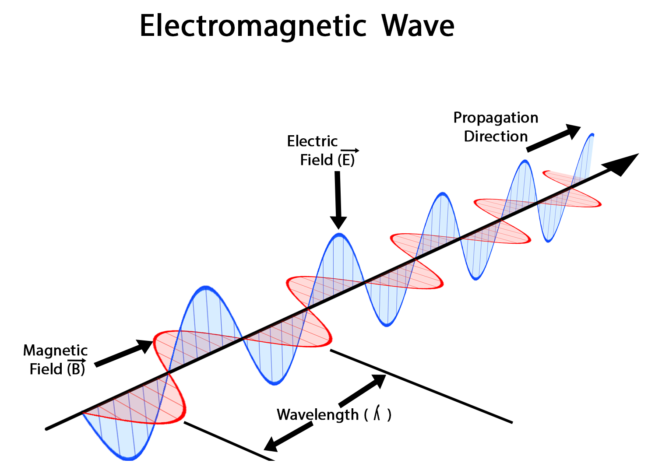

Slide 6
02. Weapons evolution

Slide 7
Around the mid-20th century, the weapons systems’ rate of development decreased.
It had reached a point when the characteristics of the weapons systems used by various military organizations were comparatively similar.

Slide 8
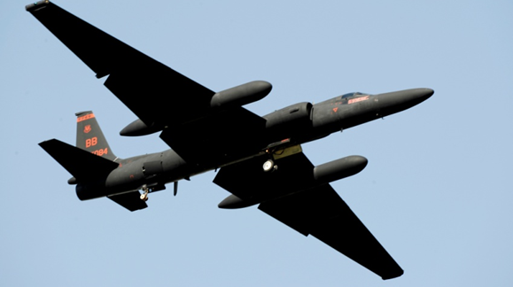

Slide 9
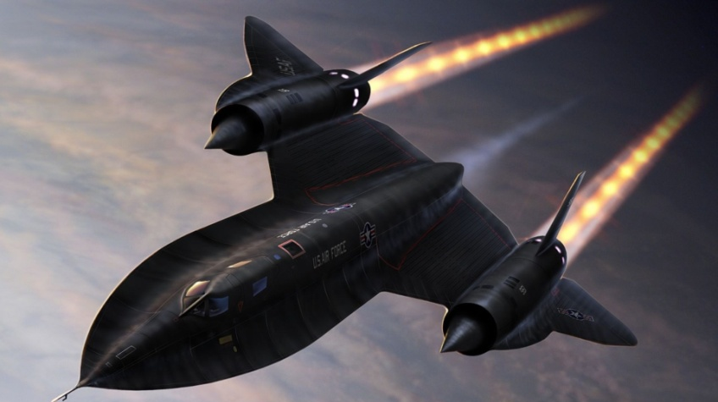

Slide 10
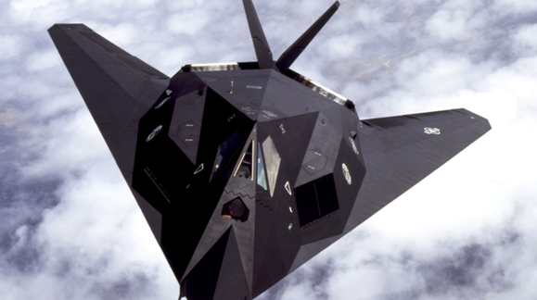

Slide 11
03. Digital Revolution

Slide 12
But in mid-20th century, something remarkable occurred: THE DIGITAL REVOLUTION.
Since the development of digital devices is exponential, it is the digital revolution that fostered the transition to the INFORMATION AGE.

Slide 13
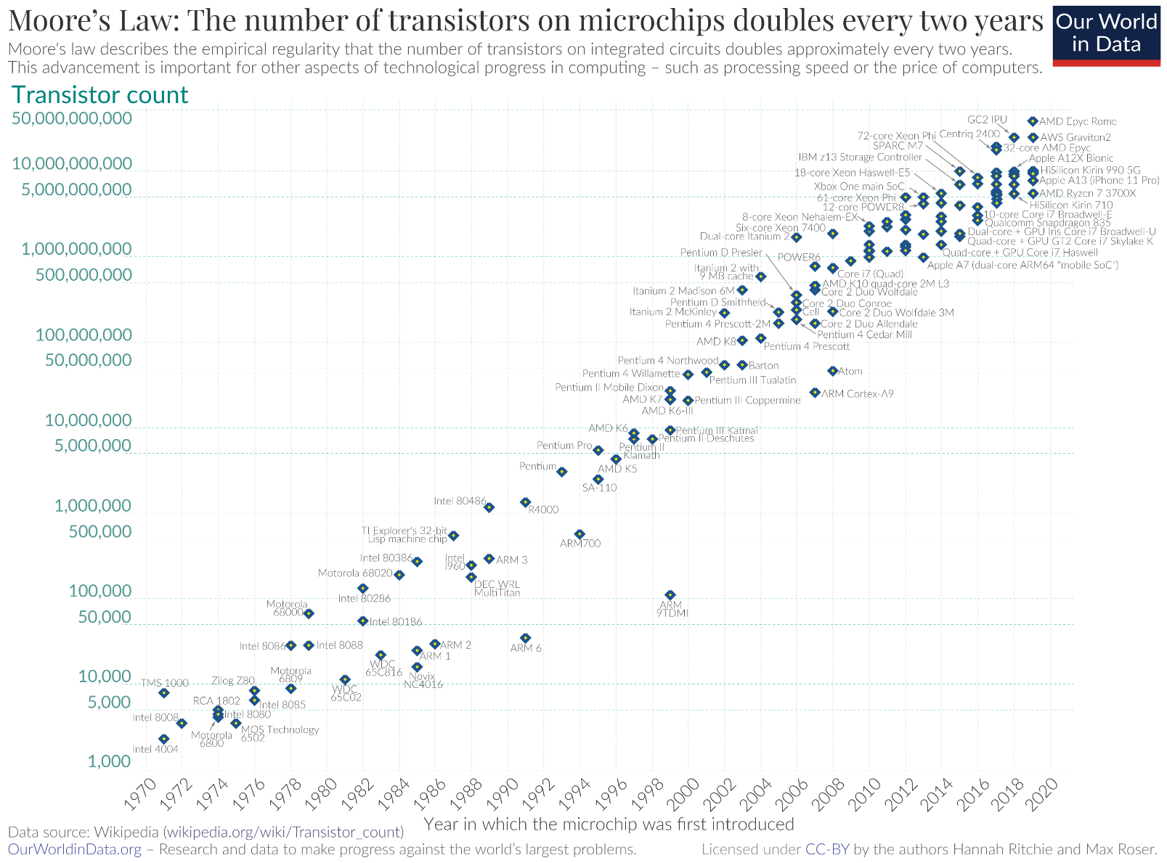

Slide 16
“Every two days now we create as much information as we did from the dawn of civilization up until 2003”.
Google CEO Eric Schmidt

Slide 17
04. Information Domains

Slide 18



COGNITIVE DOMAIN
DIGITAL DOMAIN
PHYSICAL DOMAIN

Slide 19
THE PHYSICAL DOMAIN:
is the place where those situations that the military try to influence exist;
is the domain where attacks, protection, and maneuvers occur, be it on the ground, by sea and in space;
is the domain where physical platforms and the communications networks that connect them are located.

Slide 20
THE DIGITAL DOMAIN:
is the space where information exists;
is the domain where information is created, manipulated, and transmitted;
is the domain that allows for information to be communicated among fighters;
is the domain where the command and control of the armed forces is exerted.

Slide 21
THE COGNITIVE DOMAIN :
- is the place that allows for decisions to be taken, where perceptions, awareness, understanding, beliefs and values coexist;
- is the domain of the attributes care can create an untouchable army: the leadership, morale, unit cohesion, level of training and experience, situational awareness, and public opinion;
- is the domain where doctrines, tactics, the understanding of a commandant’s intentions, techniques and procedures exist;

Slide 22
COGNITIVE DOMAIN
DIGITAL DOMAIN
PHYSICAL DOMAIN

Slide 23
Thanks

